Slide 1

Final Report Represented From Dataloops
About our company
Dataloops provides AI software solutions for businesses, specializing in natural language processing, machine learning, and computer vision to optimize operations and improve customer experience.

Slide 2
Report about Mexico Restaurant Analysis
Problem statement :
We have data about Mexico Restaurants need to discover it
Goal from Report:
Dive into this rich dataset to explore the world of consumer preferences, restaurant ratings, and culinary trends, analyze customer behavior, and optimize restaurant operations.

Slide 3

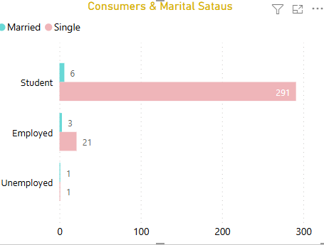
Consumer Segments
At first Start to deep on consumers segments and track their preferences in Data Features.
We noticed our customers from three segments “Students, Employment , Unemployment “
But still have categories for this segments
So , discovered marital status and noticed that some of students is married ?!
This lead us to check point if this Married students have children's or not from checking Dependents $ Independents for them.

Slide 4
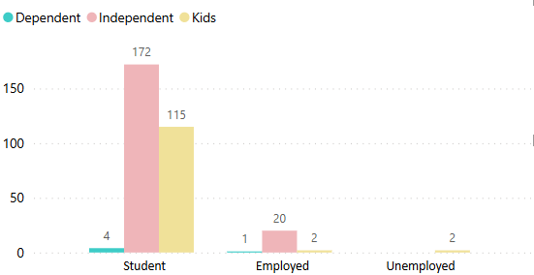
Family of consumer
The result was unexpected some of students are married and some of them are Dependent
“that mean they have children”
Here some of students have children
we may be discovered Error in this data
From previous analysis we have two unemployed consumer one married and another not married , here the two unemployed consumer are in kids' category.

Slide 5
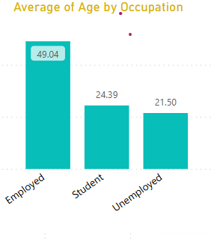
Discovery Age with Segments
Here Average of Age for our consumers according to occupation
So, we can notice that the average of Age of Unemployed is 21.5 and this may be suitable for married and get child.

Slide 6
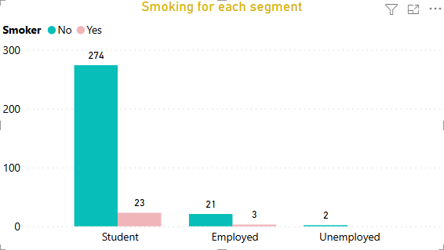
Ratio of smoking with all segments
We have small ratio of smoking in our data most of our consumers aren’t smokers
“Almost of them in students”

Slide 7
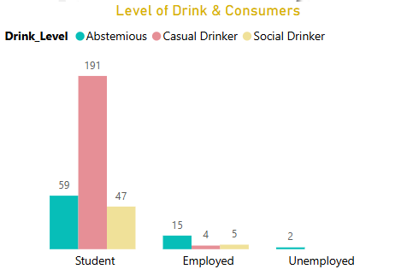
Level of Drinking For Consumers
We see that small segment of our consumers are smokers but here all consumers are drinkers but with difference levels
Most level of drinking is Casual Drinker with Students.

Slide 8
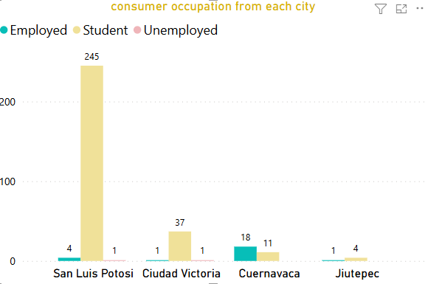
Mexico cities
Here the most city consumers of it go to Restaurant is “San Luis Potosi”
In Cuernavaca and Jiutepec city unemployment doesn’t go to Restaurants.

Slide 9
Mexico cities
Here the most city consumers of it go to Restaurant is “San Luis Potosi”
In Cuernavaca and Jiutepec city unemployment doesn’t go to Restaurants.

Slide 10
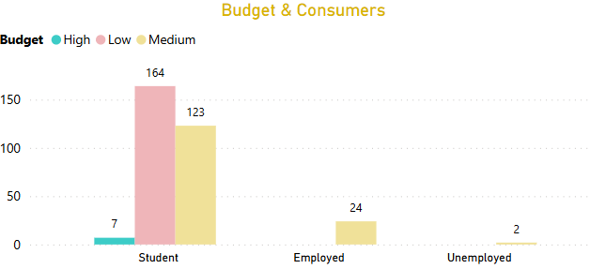
Budget & Consumers
In our data we have three Budget
“High, Medium, Low”
The most Budget used is low used by students and come after that Medium Badget.
High Budget small number use it.

Slide 11
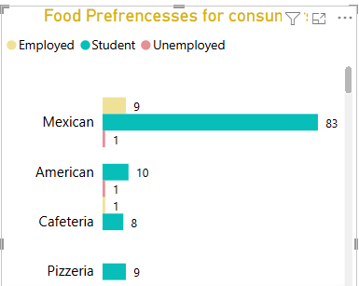
Food Preferences for Each Consumers
We have in our data 101 type of food
But only two types have a high consumption.
“Mexican and American”

Slide 12
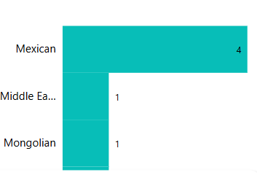
Food with high Budget
This food with high Budget and here we noticed that Each type of food have categories in Budget
Also, this mean that American food isn’t in High Budget.

Slide 13
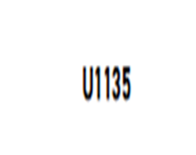
VIP Consumer
The most customer take orders with low Budget and most consumer take orders overall.

Slide 14


VIP Consumers in High”U1045” and Medium Budget “U1108”

